Slide 1
Business Architecture CORE Metamodel Submission Walkthrough
June18, 2018
Benchmark Consulting
Business Architecture Guild
Capsifi
Holocentric
TSG, Inc.
-------------------
And a cast of supporters

Slide 2
BACM Submission: Review Topics
RFP Summary of Request
RFP Examples: Business Interactions Enabled
BACM Metamodel Overview
RFP Evaluation Criteria
BACM & Base Packages
Individual Packages (normative)
Core business architecture domains
Extended business architecture domains
Normative alignment to business requirements
Alignment Guidelines (non-normative)
Alignment package
Alignment to related standards

Slide 3
BACM RFP Request Summary
BACM RFP requested a BACM submission for a standard metamodel specification for the practice of business architecture
BACM submission will incent vendors to:
Create tools to support the practice of business architecture
Promote the interchange of business architecture models between tools
Improve the consistency of the practice of business architecture
Enhance repeatability of business analysis results based on business architecture
Scope of BACM submission should include:
“Capability” as a core concept that enables other perspectives to be linked together
Sufficient number of perspectives to allow the creation of adequate business architecture models
Recommended non-mandatory value, information and organization perspectives
Touchpoints that provide usage context as crafted by the submission team
Alignment to related standards
Overview of changes made for Revised BACM Submission
Clarification on relationships and concepts in the core package for Capaibility
Clarification on relationships and concepts in the peripheral packages, particularly as related to Value and Strategy
Added in material describing alignment with UAF
RFP Figure 1:
Capability Oriented Business Perspective

Slide 4
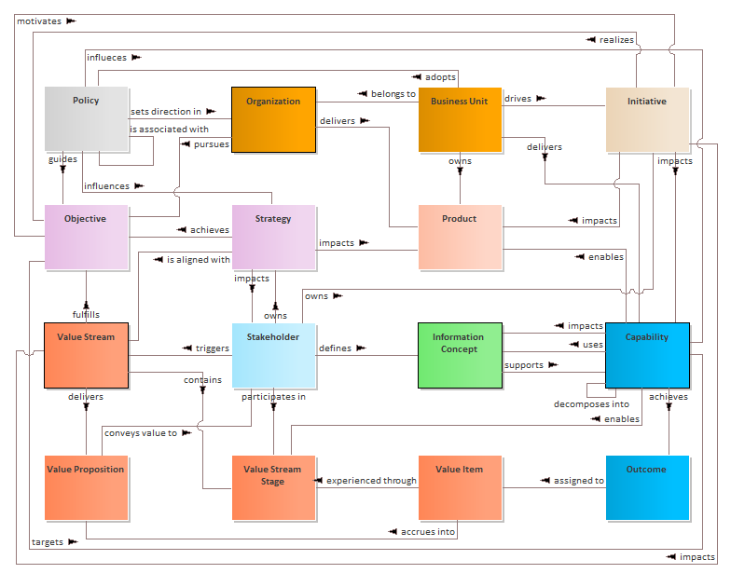
BACM Summary Perspective
Summary level BACM view
Depicts core and extended domains and associations
Color coding represents being part of the same package
This high-level perspective is not part of submission
This perspective is aligned to the BIZBOK® Guide’s principles and best practices as defined by the Business Architecture Guild
BA Guild’s BIZBOK® Guide represents the collective knowledge and best practices of a global community of close to 3000 member practitioners
Source: A Guide to the Business Architecture Body of Knowledge® (BIZBOK® Guide), v7.0

Slide 5
BACM Evaluation Criteria
Submissions shall meet the mandatory requirements (section 6.5)
Submissions will be evaluated based on the degree to which they meet optional requirements (section 6.6), where encouraged optional content is evaluated higher than other optional content
Submissions will be evaluated on the linkages between concepts in the metamodels and the adequacy of these linkages to express important business relationships
Submitted mechanisms for model alignment will be evaluated on semantic completeness and precision and its ability to support model integration
Submitters are required to provide information in their submissions showing that the concepts in their submissions are based on concepts found in business publications and practices
Submissions will be evaluated on the quality and completeness of the discussions on alignment with business relevant OMG standard metamodels

Slide 6
BACM Evaluation Criteria #1: Mandatory Requirements
Capability perspective
BACM submission leverages industry standard definition of capability as baseline for BACM (1, 2, 3)
Capability (and related affects) package includes capability concept and instance, outcome and behavioral concepts (2)
Capability aligned to business object perspective via affects package
Glossary
BACM includes sourced glossary of terms used in submission for all aspects of the metamodel
Term definitions are sourced to original vocabulary source or to the BIZBOK® Guide (2)
Touchpoint specification mechanism
BACM specifies a model integration mechanism to address touchpoint alignment and model integration (e.g., BPMN, CMMN, DMN)
Distinguishing Business Architecture elements from similar-named elements in external models
BACM / BMM alignment package aligns terminology for strategy
BACM / TOGAF alignment package aligns terminology for capability usage
BACM / VDML alignment packages align value and capability terminology
Additional alignment BACM / UAF
(1) Business Architecture Quick Guide, MK Press, ISBN 0-929652-60-6
(2) A Guide to the Business Architecture Body of Knowledge® (BIZBOK® Guide), Section 2.2, Business Architecture Guild
(3) Open Group Guide, Business Capability, ISBN 1-937218-72-0

Slide 7
BACM Submission: Summary Package
Core and extended business architecture perspectives
Expanded view

Slide 8
BACM Submission: Capability Package
Capability Package & Affects Package
Capability and decomposition / composed of relationship
Capability instances realized across an organization
Capability outcomes produced and needed
Affect on outcomes related to business objects
Capability
A particular ability or capacity that a business may possess or exchange to achieve a specific purpose or outcome.
Source: Ulrich Homann, “A Business-Oriented Foundation for Service Orientation”, 2006.
Capability Instance
A specific realization of a capability, as it exists or is envisioned to exist, in the context of a given business unit, value stream stage, or other situational context.
Unless otherwise noted, all definitions sourced: BIZBOK® Guide, Business Architecture Guild

Slide 9
BACM Submission: Business Object Package
Business Object Package defines an overall pattern that describes the structural relationships that any specific Business Object has in any of the specific conceptual packages in which it participates
Role Element Class – itself a Business Object – makes explicit the underlying relationships between specific Business Objects in any of the conceptual packages in which those Business Objects participate
Structural relationships in the Business Object Package provide a tuple template for unambiguously interpreting the content in the conceptual packages as sets of semantic triples (albeit in MOF form)

Slide 10
BACM Evaluation Criteria #2: Optional Requirements
Submissions will be evaluated based on the degree to which they meet the optional requirements
Submission that includes more optional content will be graded higher, with optional content specifically encouraged by the RFP will be evaluated higher than other optional content
Optional content includes value, information and organization perspectives and alignment between capability and these optional perspectives
BACM submission incorporates optional content:
Specified optional content is included via value package, organization package and information package
Additional optional content is included via stakeholder, product, policy, strategy and initiative packages
Additional optional content linked to operating model-based, interrelated disciplines include process, decision and case management, requirements and metric analysis
Interactions between capability and specified and additional optional content is defined across the relevant packages

Slide 11
BACM Submission - Specified Optional Content: Value Perspective
Value Package depicts
Aggregation of value items to create a value stream delivered value proposition
Association of value receiving stakeholder to value stream and related value proposition
Capability enablement of value stream stages
Capability outcomes that contribute value item
Association between capability and stakeholder value delivery
Value Item
The judgment of worth, made by an individual or organization, attached to something tangible or intangible and attained in the course of a particular interaction with one or more other parties.
Value Proposition
An innovation, service, or feature intended to make a company, product, or service attractive to customers or related stakeholders.
Value Stream
An end-to-end collection of activities that create a result for a customer, who may be the ultimate customer or an internal end-user of the value stream.
Source: Ralph Whittle and Conrad Myrick, Enterprise Business Architecture: The Formal Link between Strategy and Results (Boca Raton: Auerbach, 2005).
Value Stream Stage
A distinct, identifiable phase or step within a value stream that has a unique name, entrance criteria, exit criteria, and identifiable participating stakeholder(s).
Unless otherwise noted, all definitions sourced: BIZBOK® Guide, Business Architecture Guild

Slide 12
BACM Submission - Specified Optional Content: Information Perspective
Information Package:
Depicts information concept
Incorporates information type
Makes the business object explicit (which is associated with capability in capability and affects package)
Is linked to capability outcome in capability and affects packages
Allows for relationships among information concepts
Information Concept
Way in which to represent business terms and semantics within the context of business architecture.
Source: BIZBOK® Guide, Business Architecture Guild

Slide 13
BACM Submission - Specified Optional Content: Organization Perspective
Organization Package:
Establishes business unit and collaborative team as basic concepts
Allows for business unit decomposition and use to represent third party perspectives
Associates capability with organization via an instance of a capability
Associates performance goals with policy
Incorporates accountability with role of a decider (stakeholder)
Organization
A social unit of people, systematically structured and managed to meet a need or to pursue collective goals on a continuing basis.
Business Unit
A logical element or segment of a company (such as accounting, production, marketing) representing a specific business function, and a definite place on the organizational chart, under the domain of a manager. Also called department, division, or functional area.
Source: www.BusinessDictionary.com

Slide 14
BACM Submission: Stakeholder Perspective
Stakeholder Package
Represents value receiving and value contributing stakeholders
Depicts stakeholder association to value stream stage where value is contributed
Associates stakeholder with outcomes that contribute to value items within a value stream stage
Depicts that a (value stream) triggering stakeholder can act in a proxy role for a customer / consumer segment
Stakeholder
An internal or external individual or organization with a vested interest in achieving value through a particular outcome.
Source: BIZBOK® Guide, Business Architecture Guild

Slide 15
BACM Submission: Product Perspective
Product Package
Defines product concept, which includes product and product line
Associates product with owning business unit
Associates product with enabling capabilities
Associates product with information concept, which may manifest as an entitlement
Associates product with value proposition
Product
The overall experience provided by the combination of goods and services to satisfy the customer’s needs.
Source: Greg Geracie and Steven Eppinger, The Guide to the Product Management and Marketing Body of Knowledge® (ProdBOK®), Product Marketing and Management, 2013.

Slide 16
BACM Submission: Policy Perspective
Policy Package
Represents policy as a focal point for statutes, rules and regulations
Associates policy with business unit that adopts it and stakeholder that sets it
Associates policy with the capabilities it influences
Associates policy with information to which it relates
Policy
A course or principle of action adopted or proposed by a government, party, business, or individual.
Source: Oxford Dictionaries, Oxford University Press, s.v., “Policy”.

Slide 17
BACM Submission: Strategy Perspective
Strategy Package
Represents strategy as objectives and courses of action, reducing it to a common denominator
Associates objective with needs and expected results
Associates course of action with needs and expected results
Associates objective with change, which impacts capability
Associates rationale with change, expected results and needs
Strategy
The pattern or plan that integrates an organization’s major goals, policies, and action sequences into a cohesive whole.
Source: J. B. Quinn, Strategies for Change: Logical Incrementalism (Homewood: Richard D. Irwin, Inc., 1980).

Slide 18
BACM Submission: Initiative Perspective
Initiative Package
Defines initiative to address programs, projects and related funded actions
Depicts relation of initiative to business that it impacts and executes it
Shows relationship to the objective the initiative meets
Identifies relationships between initiative and the capabilities and value stream stages they impact
Initiative
A course of action that is being executed or has been selected for execution.
Source: BIZBOK® Guide, Business Architecture Guild

Slide 19
BACM Submission: Requirements Perspective
Requirements Package
Defines requirement, which represents any need or condition needed by a stakeholder
Enables requirements to be reflected at multiple levels
Associates requirement with the information it improves and product that it evolves
Leverages value stream and value stream stage to bound the scope of the requirement
Associates requirement to the stakeholder receiving related value of the requirement
Identifies impact of requirement on capability behavior
Associates requirement with its rationale
Frames requirement by its supporting initiative
Requirement
A condition or capability needed by a stakeholder to solve a problem or achieve an objective.
Source: A Guide to the Business Analysis Body of Knowledge (BABOK) v2.0, International Institute of Business Analysis

Slide 20
BACM Evaluation Criteria #3: concept Linkages
Submissions will be evaluated on the linkages between concepts in the metamodels and on the adequacy of these linkages to express important business relationships
BACM RFP suggested following examples of business interactions enabled by touchpoints:
Enable a business to determine strategic objectives impacting certain capabilities
Articulate capabilities necessary to enable the delivery of customer value
Determine capabilities impacted by a given initiative, program, or project
Understand how business units share capabilities with other business units
Determine capabilities packaged within or needed to enable a product or service
Show information required as an input to one or more capabilities
Define the capabilities required to deliver a given product or service to a customer
Determine capabilities linked to a given business process
BACM submission enables each of these business interactions and many more to support a wide range of business scenarios
Strategy package depicts impact on capabilities
Value package shows how capability outcomes contribute to value items, which accrue to customer value propositions
Initiative package depicts how initiatives impact a capability
Organization package depicts how business units have instances of capabilities
Product package highlights how capabilities enable products
Capability outcomes affect business objects, which are represented by information concept
Product package highlights how capabilities enable products
BPMN/CMMN/DMN alignment package represents the relationship between a capability instance and an activity in BPMN/CMMNactivity

Slide 21
BACM Evaluation Criteria #4: Model Alignment Ability
Submitted mechanisms for model alignment will be evaluated on semantic completeness and precision and its ability to support model integration (i.e., integration between a BA model and a foreign model)
Assembler
Model alignment mechanism is realized via an “Assembler”
When Assembler is realized in a model, the modeler can add properties to the Assembler object (as one would for a UML class)
The modeler can specify a query as the default value for the query attribute of the object
The assembler also incorporates the Structured Metrics Metamodel (SMM) for metric analysis
Principal example is using foreign models in BPMN, CMMN, or DMN as the source concept(s) for target concept(s) in a BA Model, but works for mapping to non-standard concepts such as those used in other BA practitioner areas

Slide 22
BACM Evaluation Criteria #5: Concept Support from Industry publications & Practices
Submitters required to provide information in their submissions showing that the concepts in their submissions are based on concepts found in business publications and practices. Submissions will be judged by completeness in justifying metamodel concepts by reference to such publications and practices, and by the commonality and quality of referenced publications and practices.
Following source references provide an example of reference section of BACM
Business Architecture Guild®, www.businessarchitectureguild.org
BIZBOK® Guide, Part 1: Introduction, http://www.businessarchitectureguild.org/?page=002.
Federation of Enterprise Architecture Professional Organizations (FEAPO), www.feapo.org.
FEAPO definition of business architecture, FEAPO Pulication Resources, http://feapo.org/wp-content/uploads/2018/05/Taxonomy-The-Federation-of-Enterprise-Architecture-Definitions-.pdf
FEAPO member listing, http://feapo.org/members/.
Business Architecture Quick Guide, MK Press, January 2018, Business Architecture Guild.
Marne de Vries et al. “A Method for Identifying Process Reuse Opportunities to Enhance the Operating Model”, IEEE International Conference on Industrial Engineering and Engineering Management, 2011. en.wikipedia.org/wiki/Operating_model.
Business Architecture: Putting “Business” into Enterprise Architecture, R. Soley and W. Ulrich, CXO Insights, May 09, 2016, http://c.ymcdn.com/sites/www.businessarchitectureguild.org/resource/resmgr/docs/putting_business_into_busine.pdf.
“A Business-Oriented Foundation for Service Orientation”, Homann, Ulrich, 2006, http://bit.ly/2faqT67.
BIZBOK® Guide, Appendix A, Glossary, http://www.businessarchitectureguild.org/?page=002.
BIZBOK® Guide, Part 1: Introduction, http://www.businessarchitectureguild.org/?page=002.
BIZBOK® Guide, Appendix A, Glossary, http://www.businessarchitectureguild.org/?page=002.
Source: Greg Geracie and Steven Eppinger, The Guide to the Product Management and Marketing Body of Knowledge® (ProdBOK®), Product Marketing and Management, 2013.
Oxford Dictionaries, Oxford University Press.
J. B. Quinn, Strategies for Change: Logical Incrementalism (Homewood: Richard D. Irwin, Inc., 1980).
BIZBOK® Guide, Appendix A, Glossary, http://www.businessarchitectureguild.org/?page=002.
A Guide to the Business Analysis Body of Knowledge (BABOK) v2.0, International Institute of Business Analysis
Structured Metrics Metamodel (SMM) standard, https://www.omg.org/spec/SMM/About-SMM/.
“A Business-Oriented Foundation for Service Orientation”, Homann, Ulrich, 2006, https://cdn.ymaws.com/www.businessarchitectureguild.org/resource/resmgr/homann_article_on_capabiliti.pdf.
Enterprise Business Architecture: The Formal Link between Strategy and Results, Ralph Whittle and Conrad Myrick, Boca Raton: Auerbach, 2005.
“The Great Transition”, Martin, James, 1995, AMACOM, ISBN-10: 0814403158.
Source: Alexander Osterwalder and Yves Pigneur, Business Model Generation, Self-Published, 2010, Page 14
BPMN 2.0 Standard, http://www.omg.org/bpmn/.
CMMN Standard, https://www.omg.org/spec/CMMN/1.0/About-CMMN/.
DMN Standard, https://www.omg.org/spec/DMN/About-DMN/.
Marne de Vries et al. “A Method for Identifying Process Reuse Opportunities to Enhance the Operating Model”, IEEE International Conference on Industrial Engineering and Engineering Management, 2011. en.wikipedia.org/wiki/Operating_model.
For example, an activity element will be associated with the flow container in which it resides (e.g., a process), but this may or may not be information needed per the methodology applied by the modeler or the tool vendor.
For example, a data object element will be associated with the activity with which it has a data association, but this may or may not be information needed per the methodology applied by the modeler or the tool vendor.

Slide 23
BACM Evaluation Criteria #6: OMG Standards Alignment
Submissions will be evaluated on the quality and completeness of the discussions on alignment with business relevant OMG standard metamodels such as VDML, BMM, BPMN, DMN, CMMN and UPDM/UAF (SMM) TOGAF
BACM alignments that follow include:
Business Motivation Model (BMM) alignment (OMG)
TOGAF alignment (capability increment) (Open Group)
Value Delivery Modeling Language (VDML) (OMG)
Business Process Model and Notation (BPMN) alignment (OMG)
Decision Management and Notation (DMN) alignment (OMG)
Case Management Model and Notation (CMMN) (OMG)
UAF (OMG)

Slide 24
OMG Standards Alignment: Business Motivation Model (BMM)
BMM Alignment
BMM alignment uses the assembler mechanism to align to two foreign model elements
Strategy package course of action is aligned to BMM course of action
Strategy package objective is aligned to BMM objective
Analysis leverages the SMM

Slide 25
OMG Standards Alignment: The Open Group Architecture Framework (TOGAF™)
TOGAF Alignment
BACM is aligned to TOGAF for purposes of capability-based planning
TOGAF incorporates the concept of a capability increment
Capability increment is a version of a capability that represents a change in the performance and maturity of the capability
Capability increment is viewed as a specialization of the Change element defined in the BACM strategy package
Change defines a relationship between a strategy package objective and before and after versions of the capability instance targeted by the change

Slide 26
OMG Standards Alignment: Value Delivery Modeling Language (VDML)
VDML Value Alignment

Slide 27
OMG Standards Alignment: Value Delivery Modeling Language (VDML)
VDML Capability Alignment

Slide 28
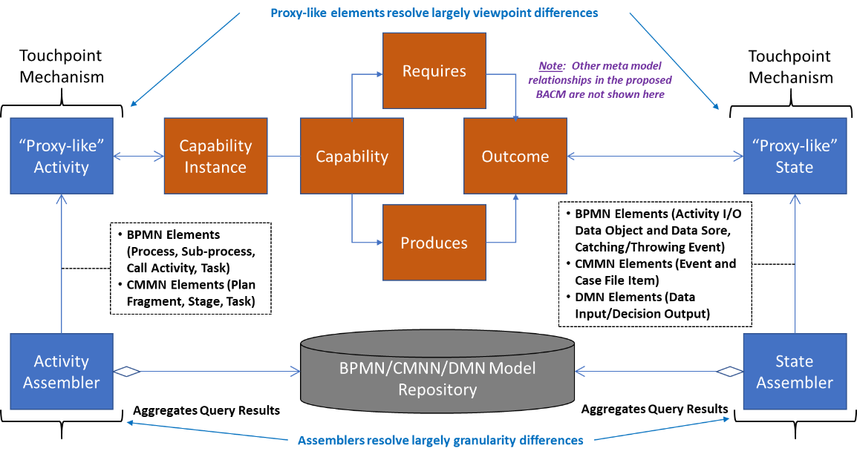
Overview of BPMN, CMMN and DMN Alignment to BACM

Slide 29
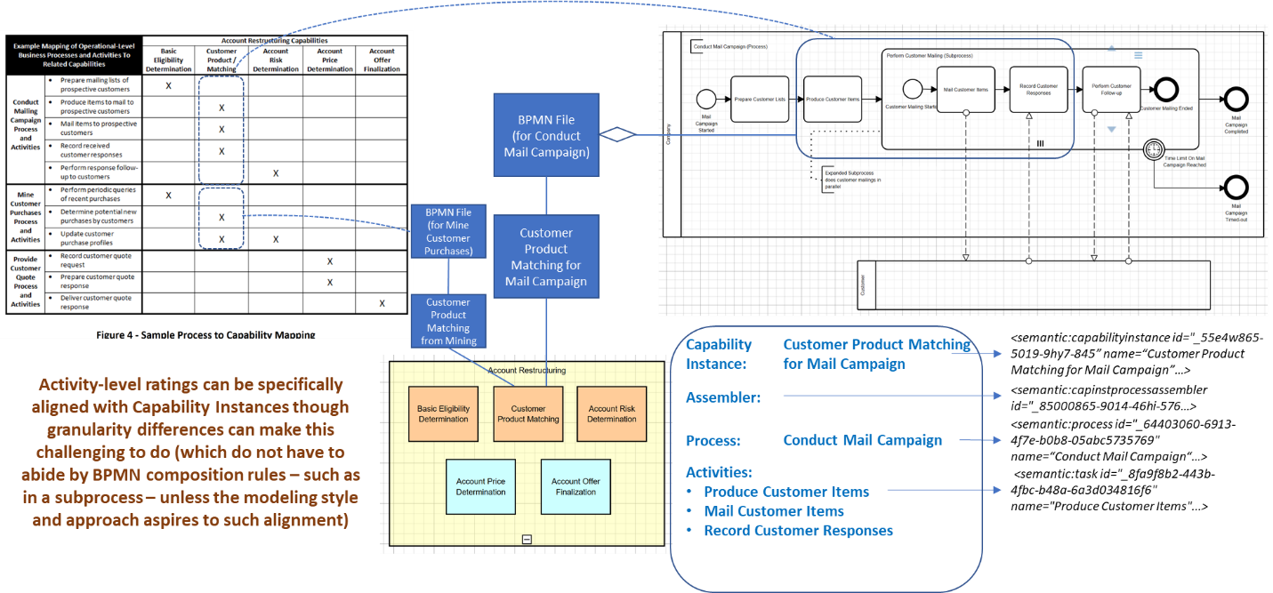
Touchpoint Alignment Example – BPMN Activity t0 Capability (through Capability instance)
Note that this example uses the BPMN XML file as the container of the foreign model with XPath used to return a node result, but alternate forms exists (e.g., model in RDF and SPARQL is used)

Slide 30
BACM to BPMN Alignment: Activity Perspective
BPMN Alignment to BACM activity perspective
Touchpoint Activity is populated by the Activity Assembler from the BPMN model (i.e. the foreign model)
Activity from the BPMN model can be retrieved with associated elements, as shown in the BPMN MM extract, or with just the Activity-level values
Touchpoint Activity is mapped to a Capability Instance, which is in turn mapped to a Capability

Slide 31
BACM to BPMN Alignment: State Perspective
BPMN Alignment to BACM state perspective
Touchpoint State is populated by the State Assembler from the BPMN model (i.e. the foreign model)
State is seen as data payloads communicated via Events from the BPMN model (shown here) or as Data Objects that have Data Input Associations or Data Output Associations from the BPMN model (not shown here), which can be retrieved with associated elements, as shown in the BPMN MM extract, or with just the Event-level values in the use of Events as the basis for State
Touchpoint State is mapped to a Outcome, and in the BACM MM Outcome has “produced” and “required’ relationships with Capability
Errata – This should have been just “State”

Slide 32
BACM to CMMN Alignment: State & Activity Perspective
CMMN Alignment to BACM activity and state perspective
Touchpoint Activity is populated by the Activity Assembler from the CMMN model (i.e. the foreign model)
Activity-like elements from the CMMN model (Task, which is similar to a Task in BPMN, or Stage, which is similar to a Subprocess in BPMN) can be retrieved with associated elements, as shown in the CMMN MM extract, or with just the Activity-like-level values
Touchpoint Activity is mapped to a Capability Instance, which is in turn mapped to a Capability
Touchpoint State is populated by the State Assembler from the CMMN model (i.e. the foreign model)
State is seen as data payloads communicated via Events from the CMMN model or as Case File Items from the CMMN model, which can be retrieved with associated elements, as shown in the CMMN MM extract, or with just the Event-level or Case File Item-level values used as the basis for State
Touchpoint State is mapped to a Outcome, and in the BACM MM Outcome has “produced” and “required’ relationships with Capability

Slide 33
BACM to DMN Alignment: State & Activity Perspective
BPMN Alignment to DMN state perspective
Touchpoint State is populated by the State Assembler from the DMN model (i.e. the foreign model)
State is seen as the set of Input Data needed by the Decision and the output of the Decision (i.e., its result), which can be retrieved as shown in the DMN MM extract
DMN has no Activity-like elements, but instead references a Business Rule Task in BPMN or a Decision Task in CMMN as the nodes in those respective models wherein the Decision is invoked
Touchpoint State is mapped to a Outcome, and in the BACM MM Outcome has “produced” and “required’ relationships with Capability

Slide 34
Conclusion

